Slide 1
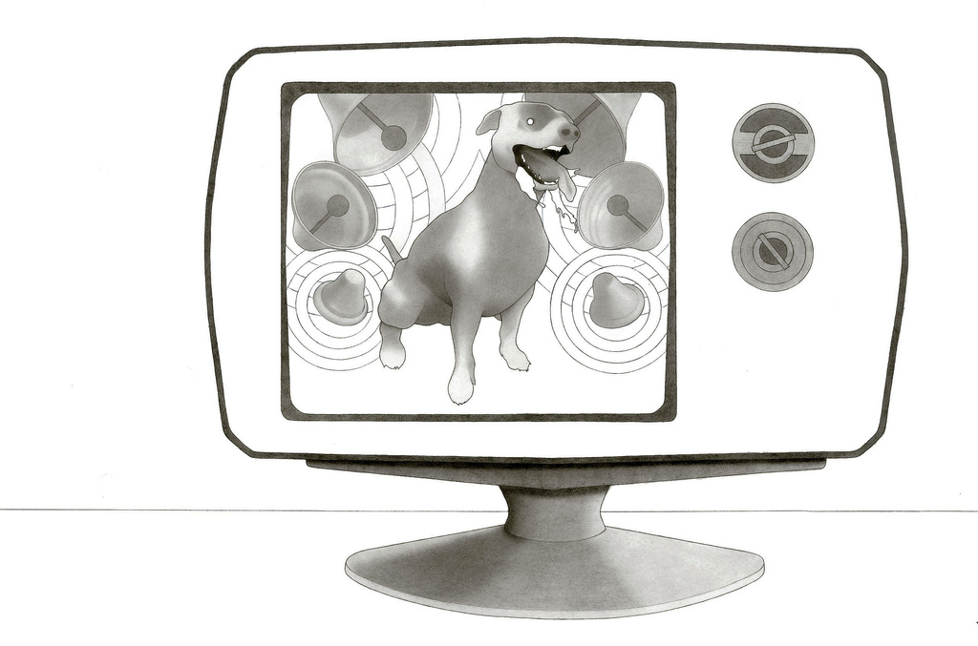

Conditioning and Learning
[Professor Name]
[Class and Section Number]
Notes:
Learning is optimally taught over a 2 class period. Learning is a topic that can start out a bit confusing for students. The meaning of learning in this discussion—classical and operant conditioning—is likely a departure from students’ common usage, broadly defined as knowledge acquisition. This module is about the underlying mechanisms for learning. There is also a lot of specialized terminology, so being mindful of pace and repeating information throughout the lectures may be helpful.
Instructor’s note: Consider administering the “Classical Conditioning With Lemonade Powder” activity during this class period to aid in the discussion. You will need to prepare it ahead of time. (for detailed instructions, see IM > Unit: Learning > Module 1: Conditioning and Learning > Activities/Demonstrations).
Warm-up Discussion: What is learning? How do we learn?
Explanation: Learning is not just the intellectual practice we often imagine it to be; it is also a reflexive/responsive process that is constantly happening, even when we’re not aware of it. Our behavior is constantly being altered by our experience, whether we know it or not, and this too is a crucial form of learning.

Slide 2
Overview Pt. 1
Behaviorism
Classical (Pavlovian) Conditioning
Types of responses
Pavlov’s experiment
Examples
Activity: Conditioned emotional response
Extinction & Blocking
Summary
Notes:
The purpose of this slide is to provide students with an overview of the material that will be covered during the lecture.
Technical Note: These slides may contain simple click animation so that you can focus students’ attention on a particular question, a selection of text, or an image and not have them be distracted by reading ahead. You can either preview the sequence of animation by going through the slides in slideshow view, visiting the animations tab, or reviewing the slide notes. In the notes you will see a cue - (Click) – that corresponds to each animation.
You will also find hyperlinks to outside videos at various places in the slides. These hyperlinks are embedded in text and indicated by color and in the notes section.

Slide 3
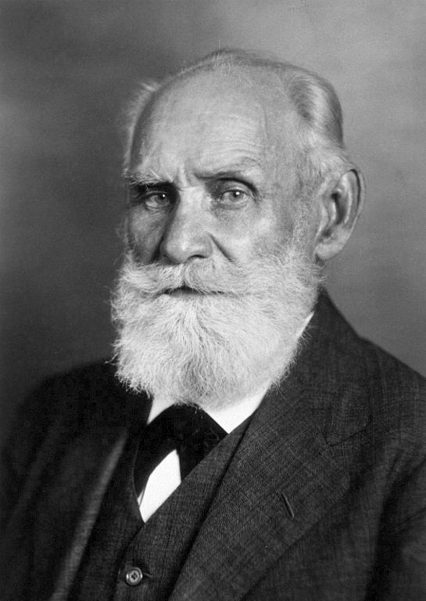
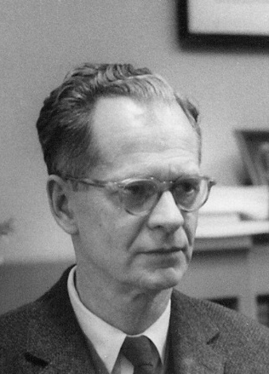
Behaviorism
Pavlov
Skinner
Notes:
This slide introduces the concept of behaviorism.
Explanation:
Behaviorism can be defined as: psychological orientation focused on the measurement of observable behavior rather than internal processes, such as thoughts. Two champions of behaviorism are Ivan Pavlov (left) and BF Skinner (right). Each contributed significant theories based on behaviorism that demonstrate the effects of psychological conditioning. The work of Pavlov and Skinner is the primary focus of this (two part) lecture.

Slide 4
Overview Pt. 1
Behaviorism
Classical (Pavlovian) Conditioning
Types of responses
Pavlov’s experiment
Examples
Activity: Conditioned emotional response
Extinction & Blocking
Summary
Notes:
The purpose of this slide is to provide students with an overview of the material that will be covered during the lecture.

Slide 5
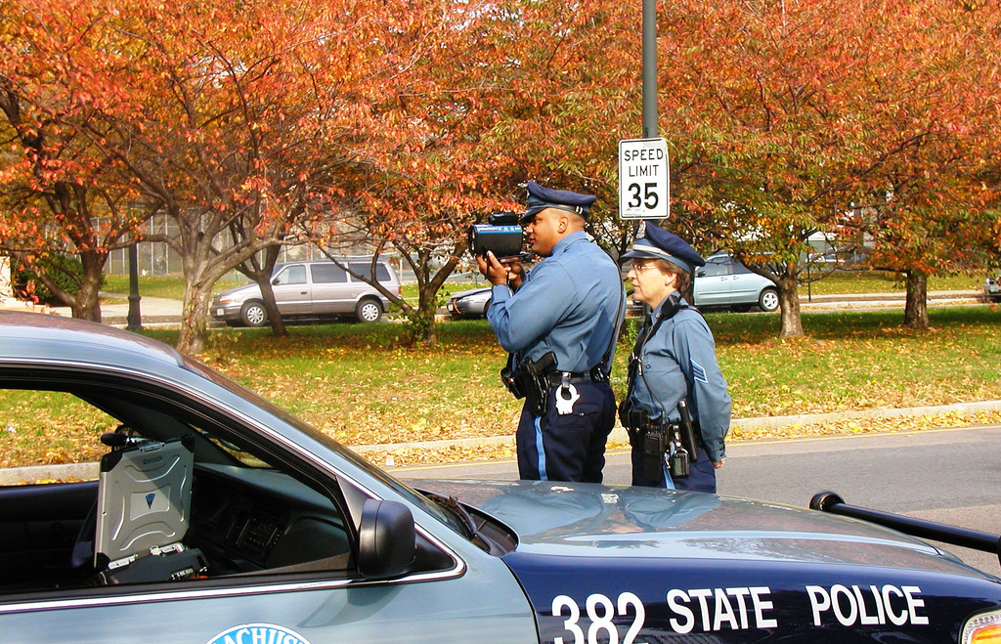
Classical Conditioning
Notes:
This slide presents the concept of classical conditioning as a process of influencing behavior.
How do you know to slow down when you see a police officer with a radar gun?
What you’re experiencing is a conditioned response:
The sight of the officer in and of itself doesn’t carry significant meaning. Yet, as the officer with the radar gun comes into view, all of the connotations associated with him/her (e.g., tickets) flood the brain and caution takes over.
Explanation: Classical Conditioning involves learning via an association between two events. In this instance—fear conditioning—the conditioned stimulus (the officer) is associated with an aversive unconditioned stimulus (the ticket).
Further Example: A famous example of classical conditioning is Pavlov’s Experiment. (Consider asking for a volunteer to explain Pavlov’s experiment, as students often have some knowledge of it via popular culture.)

Slide 6
Overview Pt. 1
Behaviorism
Classical (Pavlovian) Conditioning
Types of responses
Pavlov’s experiment
Examples
Activity: Conditioned emotional response
Extinction & Blocking
Summary
Notes:
The purpose of this slide is to provide students with an overview of the material that will be covered during the lecture.

Slide 7
Classical Conditioning Components
Unconditioned Stimulus (US) – A stimulus that elicits a particular response without prior training
Unconditioned Response (UR) – A response that occurs to a stimulus without prior training
Conditioned Stimulus (CS) – A stimulus that does not elicit a particular response initially, but comes to do so as a result of CC
Conditioned Response (CR) – The response that is eventually elicited by the conditioned stimulus after repeated pairings with the unconditioned stimulus
Notes:
This slide introduces the basic components of the classical conditioning paradigm.
Instructor’s Note: Ask students to give examples of the components as you click through. To save time, you may want to prep them before the lecture.
Students often have difficulties differentiating between these basic CC concepts. Consider providing positive reinforcement (e.g., candy rewards) for correct answers during this assignment (foreshadowing the concept of reinforcement in the Operant Conditioning slides).
(Click) Unconditioned Stimulus
Explanation: Elicits response unconditionally, regardless of the experiment (automatic trigger).
Example: The smell of cookies baking makes you hungry.
(Click) Unconditioned Response
Explanation: Response is unconditional, regardless of the experiment (automatic response).
Example: you become hungry when you smell cookies baking.
(Click) Conditioned Stimulus
Explanation: Ability to elicit response depends on an association with event (learned trigger).
Example: The sound of opening a can of tuna brings the cat running.
(Click) Conditioned Response
Explanation: Response depends on an association with event (learned response).
Example: The cat comes running when it hears the can of tuna being opened.

Slide 8
Overview Pt. 1
Behaviorism
Classical (Pavlovian) Conditioning
Types of responses
Pavlov’s experiment
Examples
Activity: Conditioned emotional response
Extinction & Blocking
Summary
Notes:
The purpose of this slide is to provide students with an overview of the material that will be covered during the lecture.

Slide 9
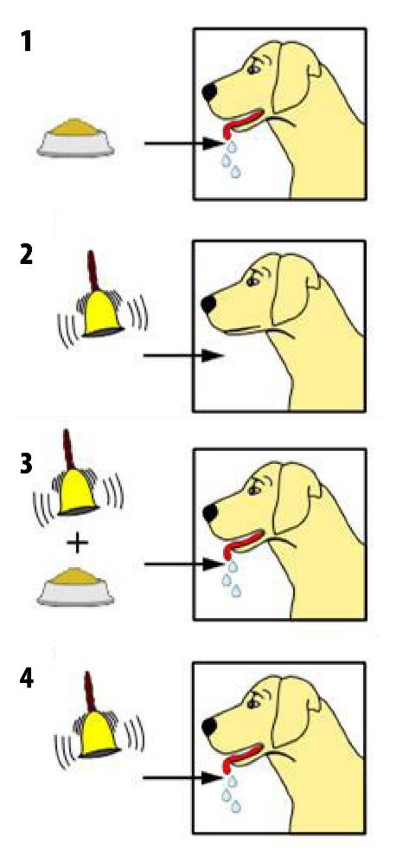
Pavlov’s Experiment
Originally
CS (Bell) → Nothing
US (Meat) → UR (Salivating)
Many Trials
CS (Bell) : US (Meat) → UR (Salivating)
Eventually
CS (Bell) → CR (Salivating)
Notes:
This slide illustrates Pavlov’s famous dog experiment.
Explanation:
At first, the dog hears the bell (CS) and does not respond. The dog has not been conditioned to react to the bell.
However, when the dog smells the meat (US), it begins to salivate (UR).
Over many trials, the bell is rung (CS) at the same time the dog smells the meat (US) and begins to salivate (UR).
Eventually, when the dog hears the bell (CS), it begins to salivate (CR) even in the absence of the meat. The dog has now been conditioned to respond to the ringing of the bell.

Slide 10
Overview Pt. 1
Behaviorism
Classical (Pavlovian) Conditioning
Types of responses
Pavlov’s experiment
Examples
Activity: Conditioned emotional response
Extinction & Blocking
Summary
Notes:
The purpose of this slide is to provide students with an overview of the material that will be covered during the lecture.

Slide 11
Classical Conditioning Examples
“The Office” Pavlovian Experiment
Discussion: What examples of CC can you think of from your own life?
Notes:
This slide presents a humorous take on Pavlov’s experiment and continues the discussion of classical conditioning.
Click the “’The Office’ Pavlovian Experiment” hyperlink in the slide to view a video demonstrating Pavlov’s experiment at work.
When watching the video, have students identify the US, CS, UR, and CR in the example:
US – Mint
CS – Computer chime
UR – Salivation when mint is presented
CR – Implied salivation/physiological response and expectation of the mint when computer chime occurs
Discussion Question: What are some examples of classical conditioning in our daily lives?
Examples:
The way a certain cologne or song reminds us of someone special or a particular event in our past.
How certain artifacts or days of the year can evoke strong emotions.
Our reactions to effective advertising campaigns, or political posturing.
Explanation: We make associations constantly, some more significant and impactful than others, and adjust our behavior accordingly, often without even realizing it.

Slide 12
Overview Pt. 1
Behaviorism
Classical (Pavlovian) Conditioning
Types of responses
Pavlov’s experiment
Examples
Activity: Conditioned emotional response
Extinction & Blocking
Summary
Notes:
The purpose of this slide is to provide students with an overview of the material that will be covered during the lecture.

Slide 13
Take out a blank sheet of paper
Take out a pen
All books and binders on the floor
Put cell phones away
Pens ready…
RELAX!
Notes:
Rules Activity:
Instructor’s Note: This slide is to provides an exercise demonstrating the generation of an emotional response, not just a physiological or behavioral response to CC. This is integral in understanding the breadth of impact that CC has, such as how CC can lead to the development of psychopathology (discussed in later slides). This link between classical conditioning and emotional responses is nuanced, and is often difficult for students to grasp.
Activity:
For this exercise, students are made to think that you are administering a pop quiz. (Do not actually confirm or deny you’re giving them a quiz; simply insist that they follow the directions. )
Begin by instructing them to take a moment and quietly follow the instructions on the slide.
Pretend to be looking at your watch (or the room clock) as if you’ll be timing them.
(Click through the slide incrementally)
Instructor’s Note: Move on to the next slide to continue the discussion about this activity and talk about the emotional responses this slide’s instructions elicited from students.
Explanation: Students often focus on the behaviors or physiological responses that result from conditioning procedures, and neglect the psychological effects.

Slide 14

Conditioned Emotional Response
Originally
CS (Instructions) → Nothing
US (Quiz) → UR (Anxiety)
Many trials
CS (Instructions) : US (Quiz) → UR (Anxiety)
Eventually
CS (Instructions) → CR (Anxiety)
Notes:
This slide provides a structural representation of the process responsible for anxiety provoked by the previous “Rules” activity.
Discussion Questions: What did you think was happening in the last slide? How did it make you feel at first? What are some of the things that went through you mind as the instructions appeared? How did the final instruction make you feel?
Explanation: The “Rules” activity demonstrates that emotions are also affected by CC, not just behavior and physiology.
Instructor’s Note: The emotional response to test situations—anxiety—is learned behavior.
(Click) Originally:
There is no objective reason for the instructions on the previous slide (CS) to cause any emotional response whatsoever. (Emphasize that the instructions themselves (e.g., taking out a blank sheet of paper) is not inherently anxiety-provoking. In fact, many of students may be able to recall days from elementary school when taking out a sheet of paper actually signaled drawing time.)
The quiz itself, however (US), does provoke anxiety (UR).
(Click) Many trials:
Over time, as students have been exposed to repeated situations wherein the instructions (CS) have been associated with a quiz (US), which causes anxiety (UR),
(Click) eventually, the instructions themselves (CS) provoke an anxious emotional response (CR).

Slide 15
Overview Pt. 1
Behaviorism
Classical (Pavlovian) Conditioning
Types of responses
Pavlov’s experiment
Examples
Activity: Conditioned emotional response
Extinction & Blocking
Summary
Notes:
The purpose of this slide is to provide students with an overview of the material that will be covered during the lecture.

Slide 16
Extinction
After conditioning
CS (Bell) → CR (Salivating)
Many Trials
CS (Bell) : US removed (No meat)
Eventually
CS (Bell) → Nothing (extinction)
Notes:
This slide presents the process of extinction.
Discussion Question: Is the learned behavior from classical conditioning permanent? How might classical conditioning be purged?
Explanation: As you might expect, classical conditioning can be undone, using the reverse method: the response to the CS can be eliminated if the CS is presented repeatedly without the US.
Example: Clinical psychologists use therapies to eliminate maladaptive and unwanted behaviors. For example, a person with a debilitating fear of spiders can be systematically exposed to spiders without a traumatic US to gradually extinguish the fear. In such a situation the spider is a CS, and repeated exposure to it without an aversive consequence causes extinction of the conditioning.
Further Discussion Question: Which do you think takes longer, the initial conditioning, or extinguishing it?
Explanation: Extinction takes significantly longer (breaking a habit is harder than forming it). There is a psychological cost to breaking a habit; our mind is geared toward making sense of our environment and forming associations. In fact, some results suggest that extinction may only inhibit rather than erase learned behavior:
Spontaneous recovery is a phenomenon whereby, if time is allowed to pass after extinction has occurred, presentation of the CS evokes a response again.
Renewal effect is a phenomenon whereby, after extinction the CS is tested in a new context, such as a different room or location, causing the response to return.

Slide 17
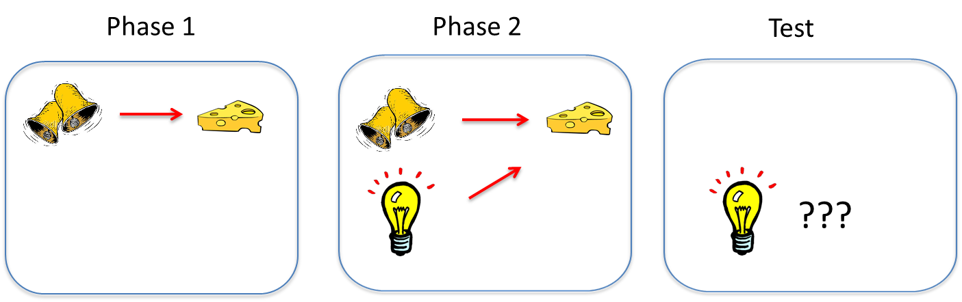
Blocking
Blocking – Occurs when a previous association prevents another association from being formed.
Notes:
This slide presents the concept of blocking.
Explanation: Blocking occurs when a previous association prevents a new association from being formed.
Example:
In the cartoon, the sound of a bell is paired with food. Once the association is learned, in a second phase, a second stimulus (light) is presented along with the bell, and the two stimuli are paired with the US together. Surprisingly, tests of conditioned responding to the light alone then show that the animal does not respond to the light alone, indicating that the animal has not learned to associate food with the light.
The earlier conditioning of the bell “blocks” conditioning of the light when the light is merely added to the bell.
The reason? The presence of the bell already predicts the US (cheese), so the US is not surprising when the light is presented with the bell. In other words, the animal attributes the presentation of the cheese to the presence of the bell, and views the light as irrelevant.
Instructor’s Note: This is often a difficult topic for students to grasp. Thus, additional example of blocking is provided in the following slide.

Slide 18
Example of Blocking
The neutral manager must give an unpopular announcement
US = Pay Cut Announcement
UR = Displeasure of staff with announcement
CS1 = Steve
CS2 = Jim
CR = Displeasure at sight of Steve
What could Jim do?
Notes:
This slide presents an alternative example of blocking.
Blocking Example Vignette:
Jim (CS2) is a new manager starting his first day of work.
Unfortunately, for Jim’s first assignment he must inform his staff that the company will be making pay cuts (US).
Jim knows that this unpopular message (US) will upset his staff (UR).
Jim also knows that Steve (CS1), a manager who has worked at the store for several years, has given many unpopular announcements in the past. In fact, staff members report becoming upset just at the sight of Steve (CR).
Discussion Question: From what we know about the CC concept of blocking, what should Jim do to avoid negative associations?
Answer: Jim should present the unpopular message WITH Steve.
Explanation: The previous association of Steve (CS1) with unpopular announcements (US) will block Jim (CS2) from being associated with the displeasure (UR/CR) felt toward the current unpopular announcement. (While this isn’t necessarily the best management advice, it is a clear example of how blocking might play out within this particular context.)
Instructor’s Note: See Appendix B for additional blocking examples.

Slide 19
Overview Pt. 1
Behaviorism
Classical (Pavlovian) Conditioning
Types of responses
Pavlov’s experiment
Examples
Activity: Conditioned emotional response
Extinction & Blocking
Summary
Notes:
The purpose of this slide is to provide students with an overview of the material that will be covered during the lecture.

Slide 20
4 Things to Know about CC
CC generates multiple responses.
CC establishes preferences AND aversions.
CC underlies various psychological conditions.
Pairing the US and CS is NOT sufficient for conditioning to occur.
Notes:
This slide presents a summary of important principles of classical conditioning.
(Click)
CC generates multiple responses.
A Pavlovian CS does not merely elicit a simple, unitary reflex (e.g., salivation). Pavlov emphasized salivation because that was the only response he measured. But his bell almost certainly elicited a whole system of responses that functioned to prepare the organism for the US (food) In addition to salivation, a CS that signals food elicits the secretion of gastric acid, pancreatic enzymes, and insulin (which gets blood glucose into cells). All of these responses prepare the body for digestion. The CS also elicits approach behavior and a state of excitement.
The conditioning takes such a strong hold, presenting a CS for food can actually cause animals whose stomachs are full to eat more food if it is available. Food CSs are prevalent in modern society, and humans can likewise eat or feel hungry in response to cues associated with food, such as the sight and feel of a bag of potato chips, the sight of a restaurant logo (like the Golden Arches), or the couch in front of the television.
(Click)
CC establishes preferences AND aversions.
Discussion Question: What are some ways Classical Conditioning causes us to favor or avoid certain things for a beneficial outcome?
Example: Animals use classical conditioning to learn what food to eat and what food not to eat. Specifically, flavors (CS) associated with a nutrition (e.g., sugar, starch, calories, or proteins; US) become preferred. In contrast, flavors associated with stomach upset or illness become avoided.
Further Explanation: Taste aversion has the rare conditioning effect of being able to form after only a single trial.
(Click)
CC underlies various psychological conditions.
Examples:
Panic Disorders and Phobias: If an experimenter sounds a tone just before applying a mild shock to a rat’s feet, the tone will elicit fear or anxiety (i.e., fear conditioning) after one or two pairings (trials). Fear conditioning plays a similar role in many anxiety disorders in humans, such as phobias and panic disorders.
Conditioned compensatory responses, substance use, and overdose: Whenever a drug is taken, it will potentially be associated with the cues that are present (e.g., rooms, odors, drug paraphernalia). A unique effect of drugs is that they often elicit responses that “compensate” for the practical purpose of the drug. For example, morphine suppresses pain, but the cues associated with morphine can tend to make us more sensitive to pain. Such conditioned compensatory responses decrease the impact of the drug on the body, making a drug user more “tolerant” to the drug in the presence of such cues (because they elicit compensatory responses). Overdose is therefore more likely if the drug is taken in the absence of those cues. Conversely, the discomfort of heightened pain sensitivity might also motivate the drug user to take the drug more often, leading to drug addiction and dependence.
(Click)
Pairing the CS and US is NOT sufficient for conditioning to occur.
Blocking is an example of this, when a secondary stimulus (the lightbulb) is paired with a US and fails to provoke a predictable CS outcome.
Conclusion Pt. 1: This concludes Part 1 of the lecture. For further exploration of the topic, consider:
Further Activity: “Classical Conditioning With Lemonade Powder” (For detailed instructions, see IM > Unit Learning > Module 1: Conditioning and Learning > Activities/Demonstrations).
CC Practice Questions/Homework: see Appendix A at the end of the slideshow.

Slide 21
Overview Pt. 2
Instrumental (Operant) Conditioning
Reinforcement and punishment
Examples
Summary
Observational Learning
Review
Appendix A: CC Practice questions
Appendix B: Alternate blocking examples
Appendix C: Supplemental Video (10:35)
Notes:
The purpose of this slide is to provide students with an overview of the material that will be covered during the lecture.

Slide 22
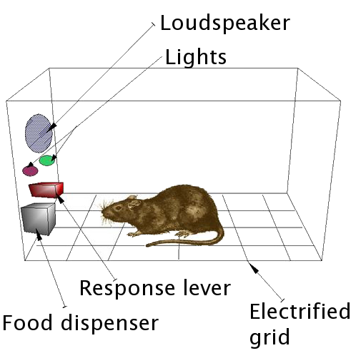
Operant Conditioning
Operant Conditioning - Occurs when a behavior is associated with a significant event.
Notes:
This slide presents the concept of operant conditioning as a process of influencing behavior.
Explanation: The second basic form of learning is Operant Conditioning—also called Instrumental Conditioning—which involves the pairing of a behavior and its consequences (i.e., what the behavior results in).
Instructor’s Note: It is important to emphasize the distinction between Classical and Operant Conditioning: While CC represents the association between two events (e.g., the presentation of the CS with the US), OC represents the association between a behavior (i.e., response) and an event.
Example: Skinner Box (depicted above); this is the best-known example of OC, whereby a rat learns to press a lever in a box in the laboratory when lever-pressing produces food pellets. The behavior is an “operant” because it operates on the environment; it is also “instrumental” for making the food occur.

Slide 23
Overview Pt. 2
Instrumental (Operant) Conditioning
Reinforcement and punishment
Examples
Summary
Observational Learning
Review
Appendix A: CC Practice questions
Appendix B: Alternate blocking examples
Appendix C: Supplemental Video (10:35)
Notes:
The purpose of this slide is to provide students with an overview of the material that will be covered during the lecture.

Slide 24
Reinforcement and Punishment
ADD
TAKE AWAY
SOMETHING
SOMETHING
INCREASE
Positive
Negative
BEHAVIOR
Reinforcement
Reinforcement
DECREASE
Positive
Negative
BEHAVIOR
Punishment
Punishment
Reinforcers increase behavior
Punishers decrease behavior
Notes:
This slide presents the concepts of reinforcers and punishers in OC.
Explanation: In Operant Conditioning, effects that increase behaviors are reinforcers; effects that decrease them are punishers.
Students frequently have a hard time distinguishing the implications of “positive” and “negative” differentiation.
The important thing to emphasize is that reinforcers increase behavior and punishers decrease behavior.
Discussion Question: What are some examples of reinforcers and punishers in everyday life?
Examples:
Positive Reinforcement = Child puts toys away and receives a cookie; the child learns to put her toys away.
Negative Punishment = A child is mean to his sibling, so you send him to his room; he learns to nicer.
Further Inquiry: Can you think of some examples of positive punishment, or negative reinforcement—by introducing a punishing condition to weaken a behavior, or removing of a punishing condition to strengthen a behavior? (These concepts are more difficult to grasp.)
Examples:
Positive Punishment = You are late to a meeting and your boss criticizes you in front of everybody; you learn to be to avoid being late.
Negative Reinforcement = You run into the house to get out of a storm; you learn to avoid the rain.
Instructors Note: It may be helpful to conduct this exercise within the context of substance abuse, as students tend to have an easier time applying these operant conditioning concepts.
Positive Reinforcement = social gain, physiological responses to the drug (the “high”)
Negative Reinforcement = alleviating anxiety/depression (self-medication), may alleviate social pressure
Positive Punishment = health concerns (e.g., dependency, cirrhosis, cancer), legal troubles
Negative Punishment = Jail, loss of employment
Further Explanation: In the context of substance abuse, reinforcers are often immediate and certain while the punishers are delayed (e.g., illness) and uncertain (e.g., there is no guarantee of health concerns or of being arrested). Thus, reinforcers tend to have a greater influence on behavior than punishers, leading people to abuse a substance without being concerned by the potential punishment.

Slide 25
Overview Pt. 2
Instrumental (Operant) Conditioning
Reinforcement and punishment
Examples
Summary
Observational Learning
Review
Appendix A: CC Practice questions
Appendix B: Alternate blocking examples
Appendix C: Supplemental Video (10:35)
Notes:
The purpose of this slide is to provide students with an overview of the material that will be covered during the lecture.

Slide 26
Operant Conditioning
“The Big Bang Theory” OC Example
Discussion: How might you use OC in your own life? How has OC been used on you in the past?
Notes:
This slide presents a humorous take on positive reinforcement and continues the discussion of operant conditioning.
Click the “’The Big Bang Theory’ OC Example” hyperlink in the slide to view a video demonstrating positive reinforcement at work.
Discussion Question: Can you think of ways your parents or teachers may have used Operant Conditioning on you?
Examples students generate might include receiving money or gold stars for good grades or behavior.
Further Discussion: It might be helpful to ask students how they might apply operant conditioning in their only lives, say, to modify the behavior of a roommate or significant other.
Instructor’s note: Consider administering the “Shaping” activity to further demonstrate the concept of operant conditioning. For detailed instructions, see IM > Unit: Learning > Module 1: Conditioning and Learning > Activities/Demonstrations.

Slide 27
Overview Pt. 2
Instrumental (Operant) Conditioning
Reinforcement and punishment
Examples
Summary
Observational Learning
Review
Appendix A: CC Practice questions
Appendix B: Alternate blocking examples
Appendix C: Supplemental Video (10:35)
Notes:
The purpose of this slide is to provide students with an overview of the material that will be covered during the lecture.

Slide 28
3 Things to Know About Instrumental (Operant) Conditioning
1. Instrumental Responses can occur under stimulus control.
2. Operant Conditioning involves choice.
3. Reinforcers are not made equal.
Notes:
This slide presents a summary of important principles of operant conditioning.
(Click)
Instrumental Responses can occur under stimulus control.
Aspects of our environment often provide cues for whether or not a behavior will result in a particular situation. Thus, we will behave one way in the presence of such a cue (i.e., discriminative stimulus) and another way in the presence of a different cue. Such behavior is considered to be under the influence of stimulus control.
Example: Students likely behave differently in the presence of their grandparents compared to the presence of peers.
Instructor’s Note: It is important to note that discriminatory stimuli can both encourage (excitatory discriminatory stimuli) or discourage (inhibitory discriminatory stimuli) behavior.
(Click)
Operant Conditioning involves choice.
Each behavior is selected from a range of optional behaviors.
Examples:
A student chooses to drink a beer instead of studying for an exam.
A rat chooses to press a lever instead of sleeping.
Explanation: This, coupled with what we have previously established about OC, indicates that behavior is determined by its own consequences AND the consequences of available alternative behaviors.
(Click)
Reinforcers are not made equal.
Operant behavior is based on how highly the subject values the reinforcer. For example, food is more reinforcing when animals are hungry than when they are not. For this reason, animals in experiments are often given less than their normal diet when experiments are running to ensure that food will always be a valued reinforcer. Furthermore, a reinfocer will be less reinforcing if there are many alternative reinforcers present.

Slide 29
Overview Pt. 2
Instrumental (Operant) Conditioning
Reinforcement and punishment
Examples
Summary
Observational Learning
Review
Appendix A: CC Practice questions
Appendix B: Alternate blocking examples
Appendix C: Supplemental Video (10:35)
Notes:
The purpose of this slide is to provide students with an overview of the material that will be covered during the lecture.

Slide 30

Observational Learning
Also called Social Learning Theory
Four Parts or Stages
Attention
Retention
Initiation
Motivation
Notes:
This slide presents the elements of observational learning.
Discussion Question: How might we describe observational learning? What are some examples of observational learning?
Example: A dancer learns a new routine by watching the choreographer perform the moves repetitively.
Explanation: Observational learning posits that individuals can learn novel responses via observation of key others’ behaviors. Those “key others” are referred to as social models, and are typically of a higher status or authority compared to the observer, such as parents, teachers, and police officers.
Four parts or Stages:
Attention
Simply, the observer must be focused on the task being learned.
2. Retention
The observer must be able to retain the learned information in memory.
3. Initiation
The observer must be able to perform the learned task; this requires access and ability.
4. Motivation
The observer must want to perform the learned task.
The next slide introduces the “Bobo doll” experiment for exploring observational learning.

Slide 31

Bobo Doll Experiment
Notes:
This slide introduces the “Bobo doll” experiment.
Albert Bandura’s Bobo doll experiment is the most famous experiment designed to explore observational learning.
Explanation: In the Bobo doll experiment, a parent (social model) interacts with a Bobo doll in front in front of the child observer. In some instances, the parent behaves aggressively toward Bobo (e.g., punching, kicking), and in other instances, the parent is gentle or playful. The results showed that children exposed to the aggressive social model were significantly more likely to mimic the abusive behavior toward Bobo, compared to those exposed to the non-aggressive model.
Click the “Bobo Doll Experiment” hyperlink in the slide to view a video demonstrating the experiment.
Further Explanation: A future adaptation of this study demonstrated that children in the aggression group showed less aggressive behavior if they witnessed the adult model receive punishment for abusing Bobo. This tempered response is a process known as vicarious reinforcement, as the children did not experience the reinforcement or punishment directly, yet it still influenced their behavior.

Slide 32
Overview Pt. 2
Instrumental (Operant) Conditioning
Reinforcement and punishment
Examples
Summary
Observational Learning
Review
Appendix A: CC Practice questions
Appendix B: Alternate blocking examples
Appendix C: Supplemental Video (10:35)
Notes:
The purpose of this slide is to provide students with an overview of the material that will be covered during the lecture.

Slide 33
Appendix A:
Classical Conditioning
Practice Questions
Notes:
Instructor’s Note: Classical conditioning practice questions can be found on the following slides. A total of 7 practice questions are provided, which can be used to supplement the basic CC components provided in the first half of the lecture or to begin a warm-up discussion for part 2.

Slide 34
Identify the CS, US, CR, and UR for each of the following scenarios:
1. Every time someone flushes a toilet in your house, the shower becomes very hot/cold and causes you to jump back. Over time, you jump back after hearing the flush, even before the water temperature changes.
2. You eat a new food and then get sick because of the flu. However, you develop a dislike for the food and feel nauseated whenever you smell it.
3. Patients with cancer who are taking chemotherapy often feel nauseated or vomit from the drugs. After several trips to the hospital to receive their chemo, they may start to feel nauseated or vomit while in the lab room, or at the site of the doctor.
4. Present people with asthma or allergies with a jar with plastic flowers in it for them to smell. This can trigger an asthma attack/allergic reaction (i.e. sneezing).
Notes:
Appendix A: CC discussion question examples 1-4.

Slide 35
Identify the CS, US, CR, and UR for each of the following scenarios:
5. You visit the eye doctor and they have you put chin on a chin rest. They perform the eye puff test and you blink a lot. After experiencing this a few times, you start blinking a lot as soon as you put your chin on the chin rest.
6. In commercials directed towards men, they often present the product along with attractive females. After seeing this commercial a few times, the male viewer feels aroused just by seeing the product.
7. During a storm, lightning often appears before you hear thunder. When you were little, you would jump or feel afraid of the thunder. After experiencing a few storms, you started to jump/ feel afraid at the sight of lightning, before the thunder even occurred.
Notes:
Appendix A: CC discussion question examples 5-7.

Slide 36
Overview Pt. 2
Instrumental (Operant) Conditioning
Reinforcement and punishment
Examples
Summary
Observational Learning
Review
Appendix A: CC Practice questions
Appendix B: Alternate blocking examples
Appendix C: Supplemental Video (10:35)
Notes:
The purpose of this slide is to provide students with an overview of the material that will be covered during the lecture.

Slide 37
Appendix B: Alternative Blocking Example
Notes:
Instructor’s Note: The following slides provide an additional example to further illustrate the concept of blocking detailed in the first half of the lecture.

Slide 38
Blocking Example
You go to Grandma’s one Sunday and she makes herbal tea, which you rarely drink. After leaving, you happen to come down with the flu and get sick to your stomach. What is likely to happen?
The next Sunday, you are over the flu, and go to Grandma’s again. This time she serves chocolate chip cookies with the same herbal tea. You consume both to be polite. You feel sick to your stomach after eating and drinking.
Do you associate the upset feeling with the tea? With the cookies? With both? Are you likely to avoid both tea and cookies in the future?
Identify/Answer the Following:
The 1st CS paired with the US
What is your UR/CR?
The 2nd CS paired with 1st CS and the US
Do you respond to 1st CS? To 2nd CS?
Notes:
Appendix B: Blocking example and questions
Instructor’s note: It is important to emphasize that this example involves both the formation of taste aversion (herbal tea) and blocking. To decrease confusion generated by the large amount of text on the slide, relevant stimuli and responses are highlighted in red.
Answers are on the following slide.

Slide 39
Blocking Example
US = flu
UR = illness (nausea)
CS = tea
CR = taste aversion (nausea experienced -> tea)
CS2 = cookies
The association has already been formed between tea and illness, thus no association is formed with cookies and illness.
Notes:
Appendix B: Blocking example answers

Slide 40
Overview Pt. 2
Instrumental (Operant) Conditioning
Reinforcement and punishment
Examples
Summary
Observational Learning
Review
Appendix A: CC Practice questions
Appendix B: Alternate blocking examples
Appendix C: Supplemental Video (10:35)
Notes:
The purpose of this slide is to provide students with an overview of the material that will be covered during the lecture.

Slide 41
Appendix C:
Supplemental video:
Nova Science Now
Smart Marine Mammals
(2009)
Run time – 10:35
Notes:
This slide provides a supplemental video for optional further discussion.
Click the “Nova Science Now Smart Marine Mammals” hyperlink in the slide to view the video.
Discussion topic: What are some of the learning behaviors observed in the video? What might we learn from studying animal learning behaviors?

Slide 42
Appendix C:
Slide 1 | Photo Credit: Carl Glover https://www.flickr.com/photos/34239598@N00/3870211358/ https://creativecommons.org/licenses/by/2.0/
Slide 3 | Photo Credit: http://commons.wikimedia.org/wiki/File%3AIvan_Pavlov_NLM3.jpg http://en.wikipedia.org/wiki/en:public_domain
Slide 3 | Photo Credit: http://commons.wikimedia.org/wiki/File:B.F._Skinner_at_Harvard_circa_1950.jpg#mediaviewer/File:B.F._Skinner_at_Harvard_circa_1950.jpg http://en.wikipedia.org/wiki/en:public_domain
Slide 4 | Photo Credit: Steven Yeh http://www.sense.bc.ca/wp-content/uploads/2013/02/60115419_c12acad3ff_b-600x400.jpg https://creativecommons.org/licenses/by-nc-nd/2.0/
Slide 9 | Photo Credit: http://commons.wikimedia.org/wiki/File%3APalov's_dog_conditioning.svg https://creativecommons.org/licenses/by-nc-nd/2.0/
Slide 14 | Photo Credit: Firesam! https://www.flickr.com/photos/firesam/5242760927/ https://creativecommons.org/licenses/by-nd/2.0/
Slide 22 | Photo Credit: http://commons.wikimedia.org/wiki/File:Skinner_box_scheme_01.png#mediaviewer/File:Skinner_box_scheme_01.png https://creativecommons.org/licenses/by-nd/2.0/
Slide 30 | Photo Credit: horizontal.integration https://www.flickr.com/photos/ebolasmallpox/2100537142/ https://creativecommons.org/licenses/by-nc-sa/2.0/
Slide 31 | Photo Credit: Sémhur http://commons.wikimedia.org/wiki/File:Bobo_doll-en.svg http://creativecommons.org/licenses/by-nc-nd/3.0/
Notes:
This slide provides a supplemental video for optional further discussion.
Click the “Nova Science Now Smart Marine Mammals” hyperlink in the slide to view the video.
Discussion topic: What are some of the learning behaviors observed in the video? What might we learn from studying animal learning behaviors?

